Slide 1
Modularization in Software
– the enabler for the feature-selling business of tomorrow
A teaser for The Terma radar Challenge
at NEM Bi-annual meeting on 8-9 October 2024 prepared by:
Morten Helbo LUnd, Senior Architect, Radar Software
Claus Tarnow Møller-Hundborg, Chief Architect, Radar
Martin Elkjær, VP, Radar & Hardware Systems, R&D

Slide 2
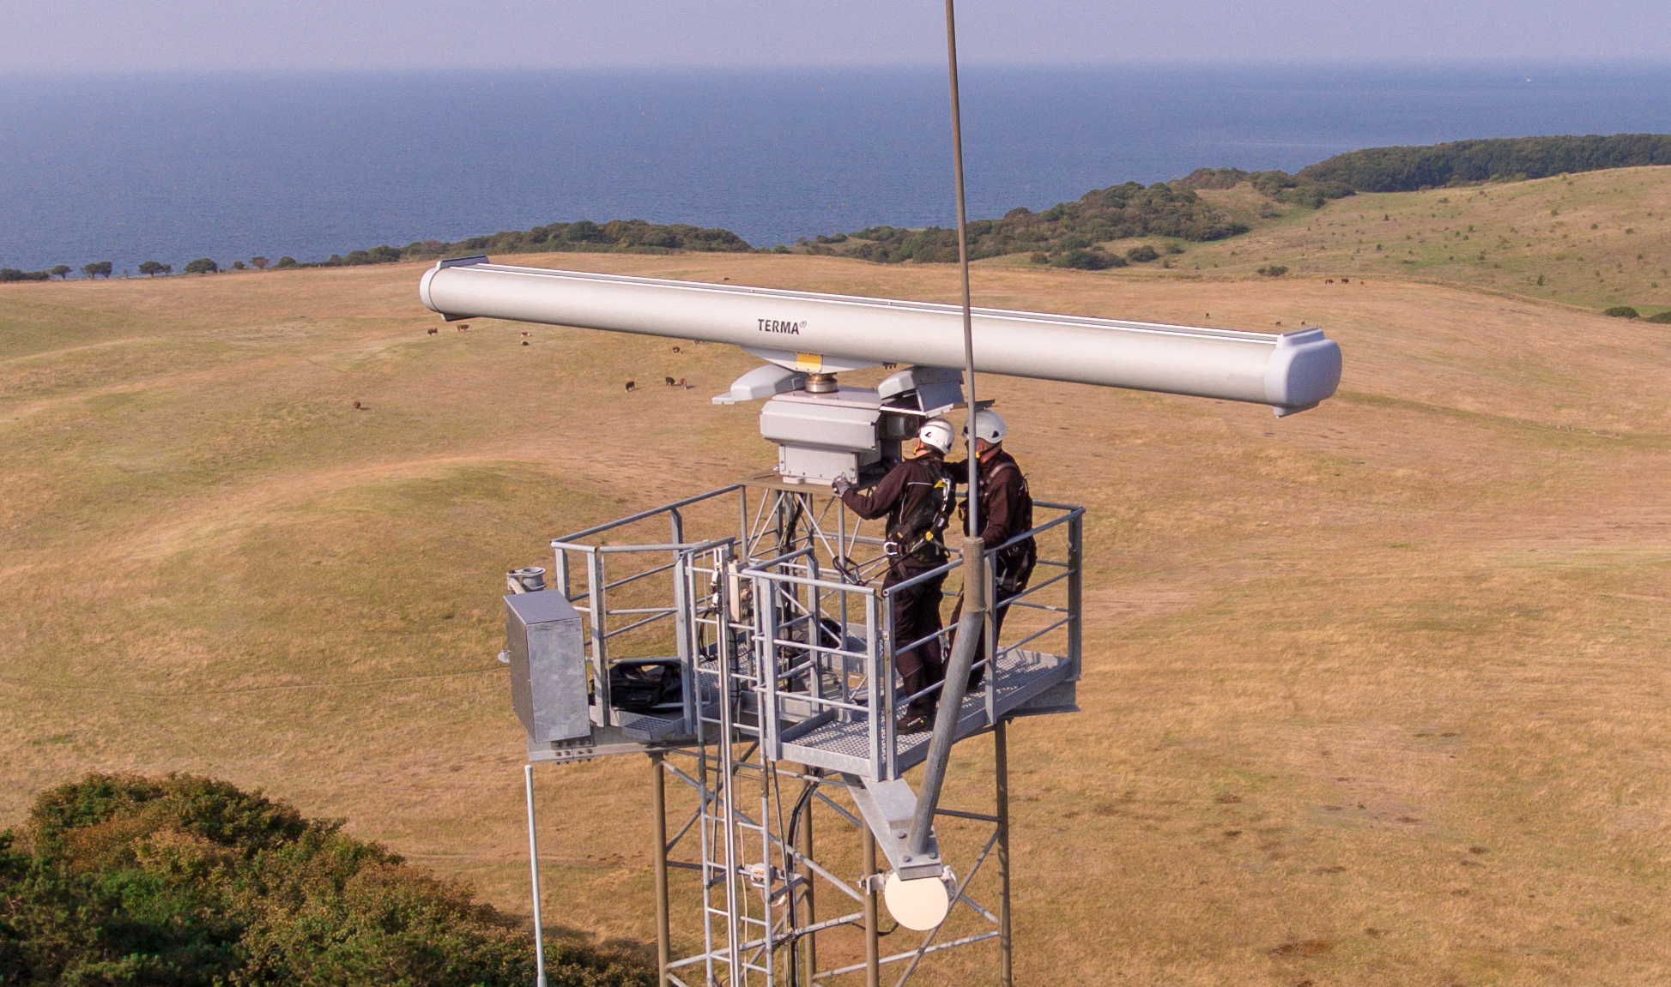
Modularization in Software
– the enabler for the feature-selling business of tomorrow
Key Question
Might the modular-approach
be the “balancing act”
we need to go from chaotic to managed flexibility in the feature-/license-based business of the tomorrow?
Participants (non-exhaustive)
BD, Sales, and R&D Leaders
Product Managers
Platform/Product Architects
Modularization Experts
Agenda (11 AM-5 PM, Day 1of2)
Terma Intro incl. MOD History
Lunch
The Terma Radar Challenge
  Radar business background
  and intro to challenges
  Breakout in groups
  Recap and Take Aways
Take Aways
Software Modularization as enabler of (new) financial models,
e.g., licenses vs products sales.
Management of dynamic configuration and seamless upgrade of functionality throughout the product lifetime, e.g., digital passport.
Continuous verification of requirements in terms of compliance,
e.g., performance, safety, cyber security (and validation of features).

